Slide 1


Slide 6
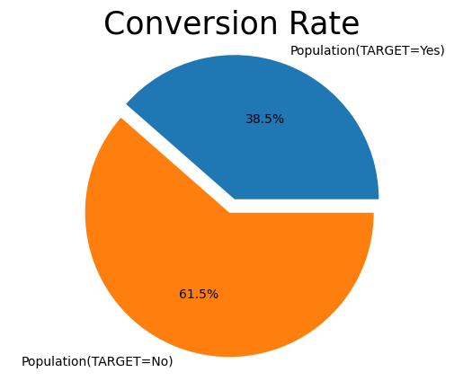

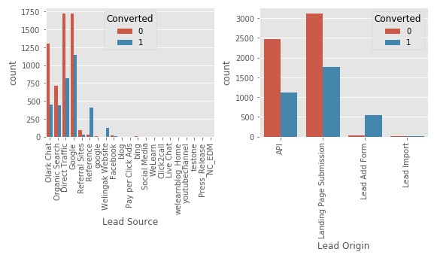




EXPLORATORY DATA ANALYSIS
The conversion rate of the leads from Reference and Welingak Website is maximum
API and Landing Page Submission has less conversion rate(~30%) but counts of the leads from them are considerable
The count of leads from the Lead Add Form is pretty low but the conversion rate is very high
Conversion rate as depicted in the fig is approx. 39%

Slide 8
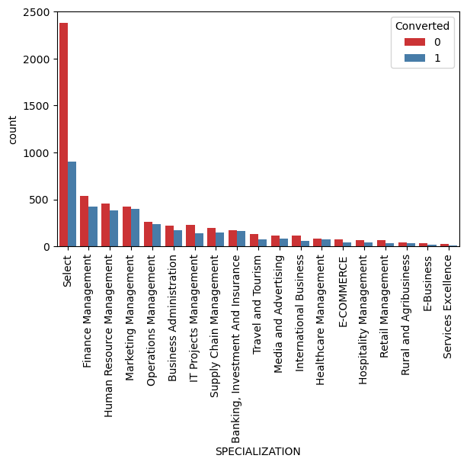
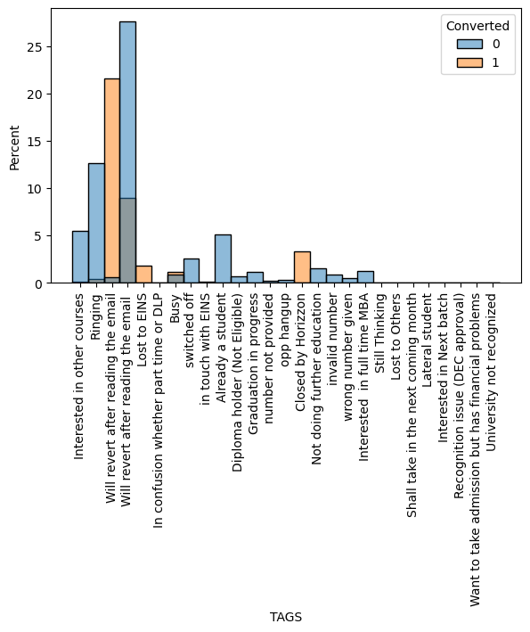
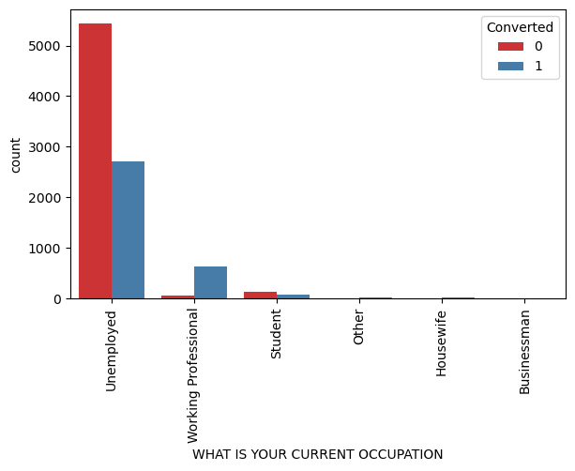
EXPLORATORY DATA ANALYSIS
Looking at above plt, no inference can be made for specialization.
Working Proffessional has high conversion rate
Un employed leads are more than other category.
“Will revert after reading email” has high percentage of being converted.

Slide 9
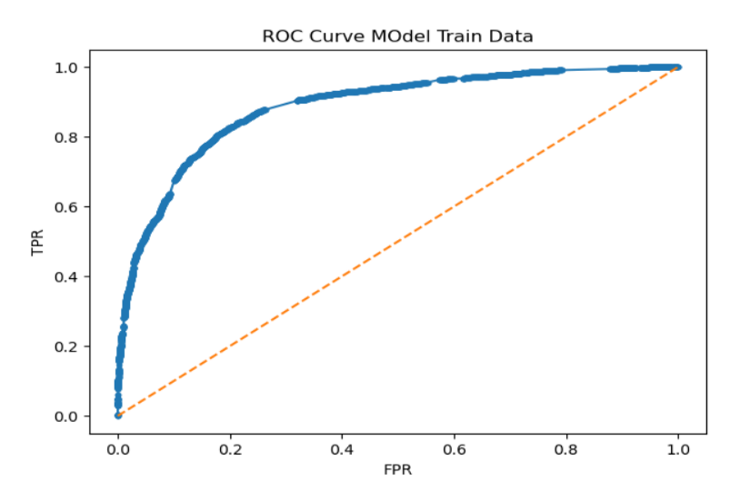

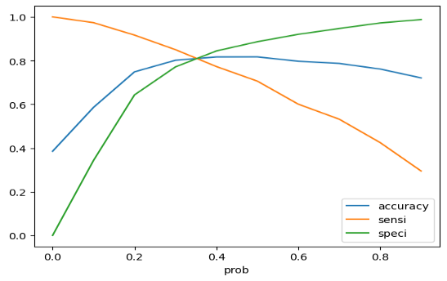
MODEL BUILDING
SPLITTING THE DATA INTO TEST AND TRAINING SETS
WE HAVE CHOSEN THE TRAIN_TEST SPLIT RATIO AS 70:30
USING RFE TO CHOOSE TOP 20 VARIABLES
BUILD MODEL BY REMOVING THE VARIABLES WHOSE p-VALUE
> 0.05 AND VIF > 5
PREDICTIONS ON TEST DATASET
OVERALL ACCURACY IS 81.6%
OPTIMAL CUT OFF POINT OF 0.37 AS DEPICTED IN THE FIGURE.
ROC CURVE
OPTIMAL CUT-OFF

Slide 11
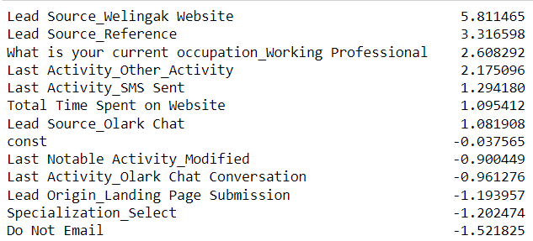

MODEL EVALUATION
FEATURE IMPORTANCE
ACCURACY, SENSITIVITY AND SPECIFICITY FOR
VARIOUS PROBABILITY CUTOFFS FROM 0.1 TO 0.9
AS PER THE GRAPH AND LOOKING AT THE OTHER SCORES, IT CAN BE SEEN THAT THE OPTIMAL POINT IS 0.37
METRICS SCORE(TEST DATA)
PREDICTED ACTUAL | NOT CONVERTED | CONVERTED
NOT CONVERTED | 1468 | 266
CONVERTED | 234 | 755
ACCURACY | 81.6%
PRECISION | 73.9%
SENSITIVITY | 76.3%
SPECIFICITY | 84.6%

